Slide 1

All That Remains
Licenciatura de Videojogos
Desenvolvimento de Jogos Digitais 2
2020/2021
What you remember may be the missing piece
Concept Pitch
Afonso Lage - 21901381 André Santos – 21901767 Miguel Feliciano - 22002782

Slide 2
Genre
3D
First-Person
Adventure
Puzzle
Low-Poly

Slide 3
The Game
Explore your memories
Investigate your childhood home
Find your missing parents
Solve puzzles to progress
Collect the tapes left by your parents

Slide 4
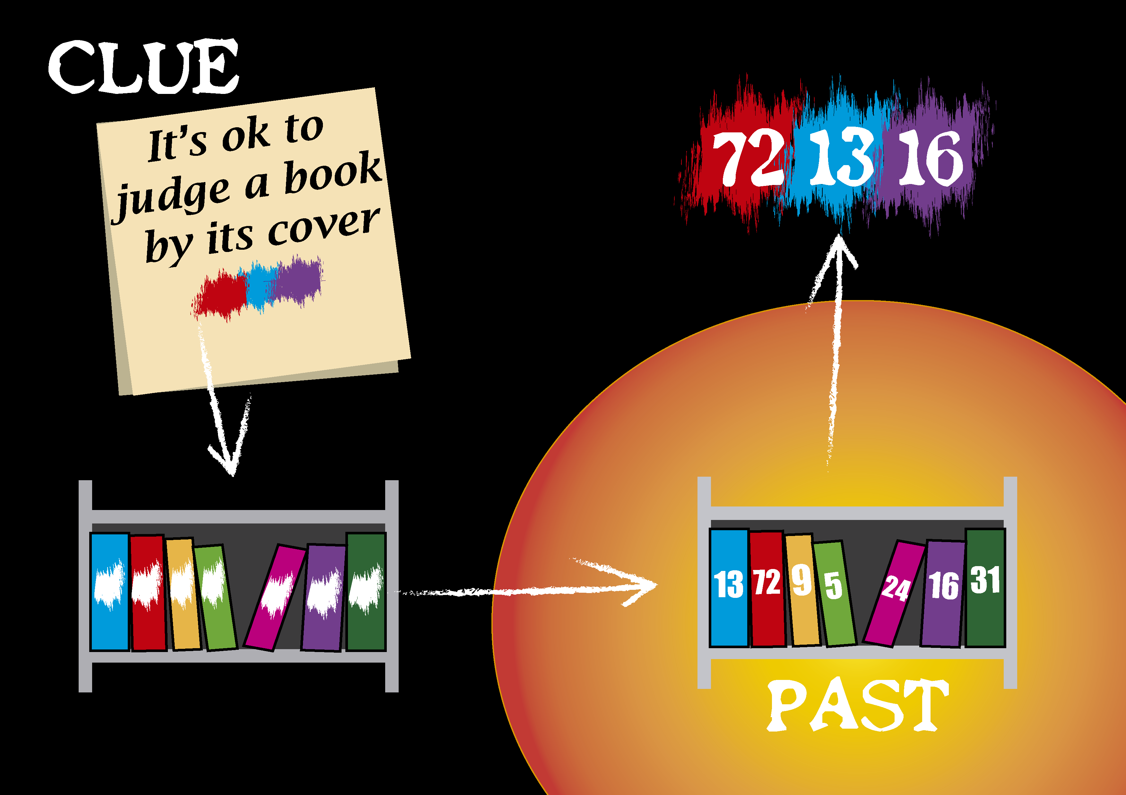

Slide 5
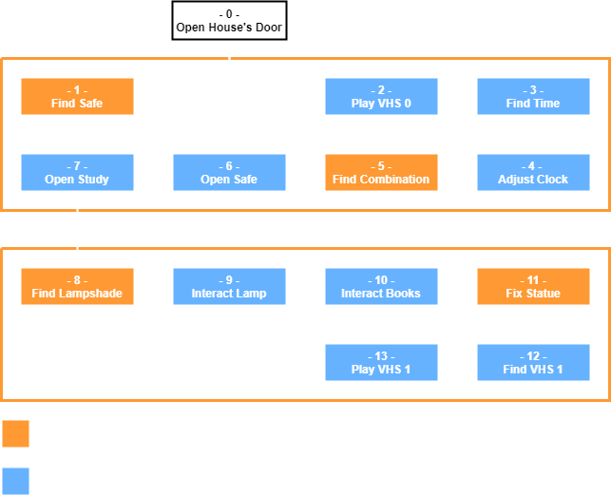

Slide 6
All That Remains
Licenciatura de Videojogos
Desenvolvimento de Jogos Digitais 2
2020/2021
What you remember may be the missing piece
Concept Pitch
Afonso Lage - 21901381 André Santos – 21901767 Miguel Feliciano - 22002782

